Slide 1


Review of Virtual Neutron and x-raY Laboratory (WP5)
1 September 2021
Authors: Andy Götz (coordinator)+ Carsten Fortman-Grote (WP5 leader)
Place: PaNOSC Project Management Committee zoom meeting
This project has received funding from the European Union’s Horizon 2020 research and innovation programme under grant agreement No. 823852

Slide 2

What is the VINYL ?

Slide 3
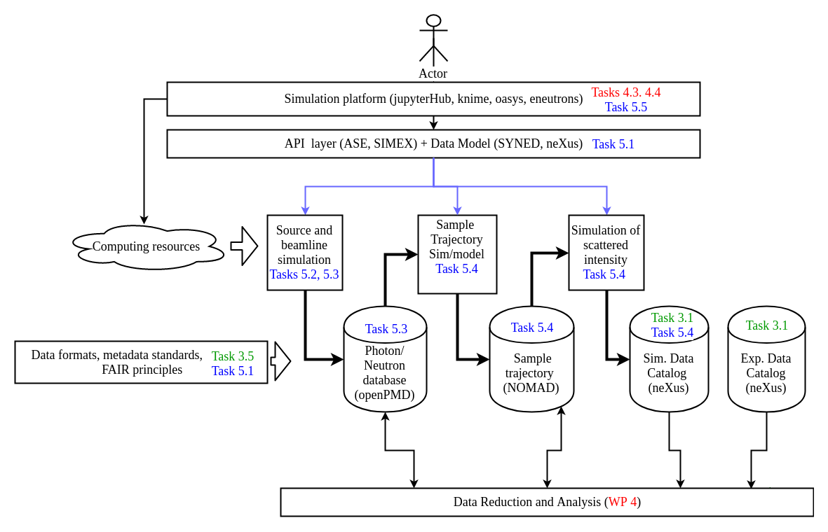
What is the VINYL ?

Slide 4
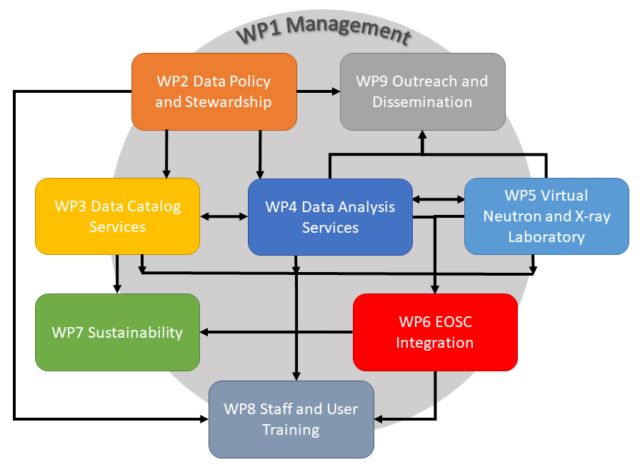
WP5
VINYL – role in PaNOSC
This project has received funding from the European Union’s Horizon 2020 research and innovation programme under grant agreement No. 823852

Slide 5
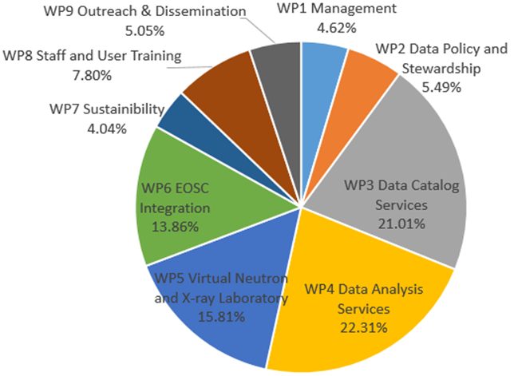
WP5
VYNIL – 3rd largest WP of PaNOSC
This project has received funding from the European Union’s Horizon 2020 research and innovation programme under grant agreement No. 823852

Slide 6
WP6
Sustainability – Effort per partner
1 – EuXFEL 48.00 (WP leader)
2 – ESS 40.00
3 – ESRF 40.00
4 – CERIC-ERIC 40.00
5 – ILL 36.00
6 – ELI-DC 12.00
Total 219.00 (~ 18 years)
This project has received funding from the European Union’s Horizon 2020 research and innovation programme under grant agreement No. 823852

Slide 7
WP5 Objectives from Proposal
Expose existing instrument and experiment simulations capabilities as a virtual facility service in the EOSC to promote the access and integration of simulated data in complex analysis workflows. Build on outcomes of EUCALL (SIMEX).
Effort will be on 4 levels:
Framework: providing a flexible simulation framework that enables users to rapidly implement simulation and analysis workflows.
Simulation: Make simulation data services inter-operable through development of appropriate APIs and adoption of open data standards.
Linking: link the EOSC experiment simulation services to their in-house data reduction, analysis, and visualization infrastructures
Education: develop simulation applications suitable for education

Slide 8
WP5 Tasks from Proposal
Task 5.1 Simulation Infrastructure (EUXFEL)
Task 5.2 Photon and Neutron Source simulation data services (ESRF)
Task 5.3 Photon and Neutron beamline simulation data services (ILL)
Task 5.4 Simulation of signal generation including radiation-matter interaction (ESS)
Task 5.5 Integrated simulation data workflows (EUXFEL)

Slide 9
WP5 Deliverables from Proposal
Deliverable 5.1 Prototype simulation data formats (M12, ESS)
Deliverable 5.2 Documented simulation APIs (M24, EUXFEL)
Deliverable 5.3 Documented simulation tasks executable (M42, ILL)
Deliverable 5.4 Software tested and released including interactive simulation and analysis workflow (M48, ESRF)

Slide 10
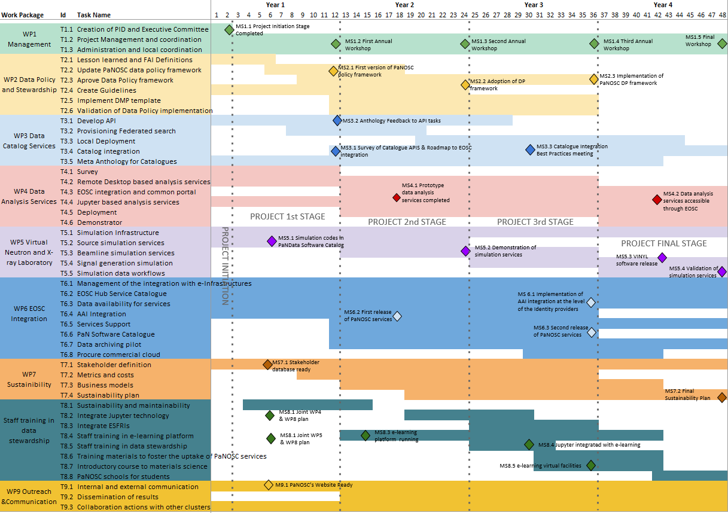
PaNOSC Milestones
September 2021

Slide 11
What WP5 needs to sustain …
Data format – HDF5/Nexus, openPMD, NOMAD
Simulation software –
SIMEX (EUXFEL, ELI, ESS, ILL)
McStasScript (ESS)
Laser simulation s/w (ELI)
OASYS (ESRF, CERIC-ERIC)
Workflows (ESRF)
Visualisation software – h5web (ESRF), laser s/w (ELI)
Training material for simulation on pan-learning.org
Software registered in software catalogue

Slide 12
Issues for WP5 in PaNOSC
Engagement
Lack of engagement (ESRF) – should be recovered by workflows + visualisation
EGI resources
Lack of sites using the EGI compute resources (only ELI used EGI resources)
Commercial cloud – few use cases

Slide 13
PaNOSC WP6 spending up to 31/3/2021
WP6
Spent: 99% of PM, 83% in Euros

Slide 14
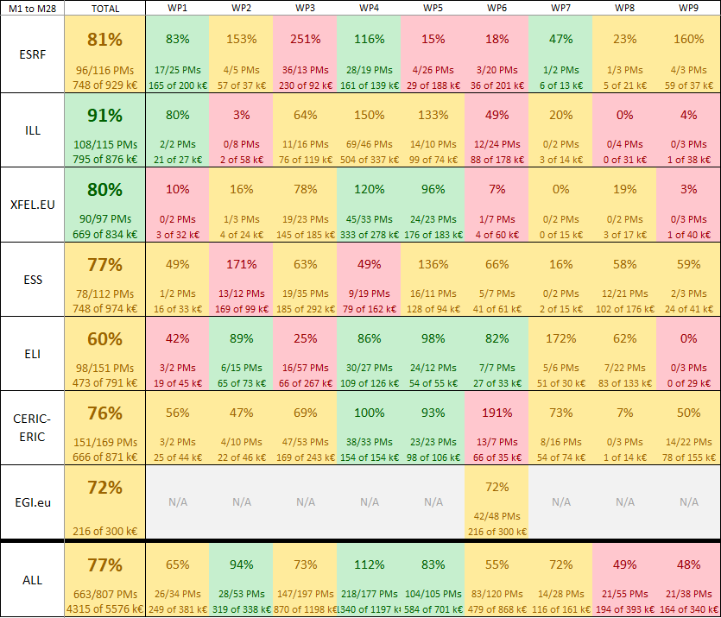
PaNOSC WP5 spending up to 31/3/2021
WP5
Underspending by ESRF

Slide 15
For the remainder of PaNOSC
All partners to continue the excellent engagement in WP5 activities etc.
ESRF to increase spending on WP5 to include workflows and visualisation
Complete WP5 training material

